Slide 1
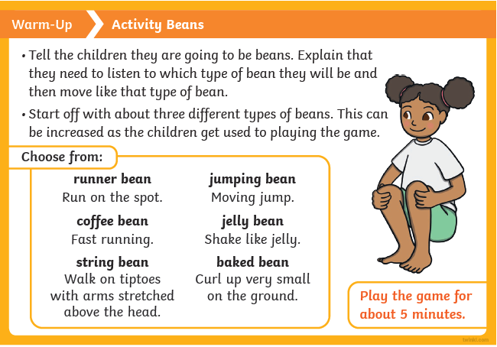
Lets warm up our bodies!
Gross Fundamental movement skills they have already acquired: - rolling - crawling - walking - jumping - running - hopping - skipping – climbing

Slide 2
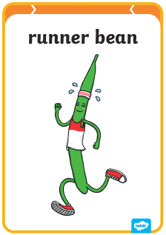

Slide 3
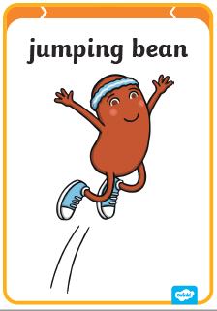

Slide 4
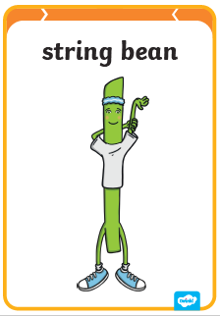

Slide 5
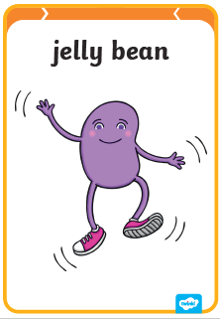

Slide 6


Slide 7
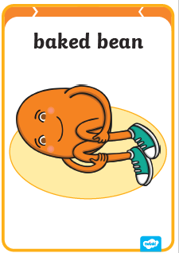

Slide 8

Can you do a…
Gross Fundamental movement skills they have already acquired: - rolling - crawling - walking - jumping - running - hopping - skipping – climbing

Slide 9
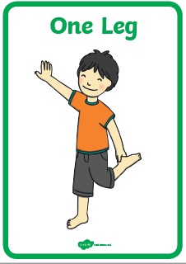
Can you do a…
Gross Fundamental movement skills they have already acquired: - rolling - crawling - walking - jumping - running - hopping - skipping – climbing

Slide 10
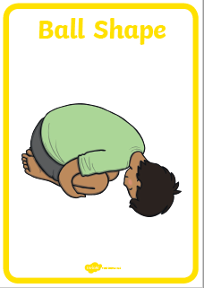
Can you do a…
Gross Fundamental movement skills they have already acquired: - rolling - crawling - walking - jumping - running - hopping - skipping – climbing

Slide 11
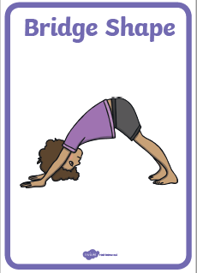
Can you do a…
Gross Fundamental movement skills they have already acquired: - rolling - crawling - walking - jumping - running - hopping - skipping – climbing

Slide 12
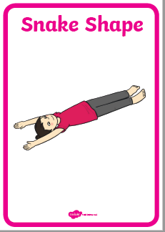
Can you do a…
Gross Fundamental movement skills they have already acquired: - rolling - crawling - walking - jumping - running - hopping - skipping – climbing

Slide 13
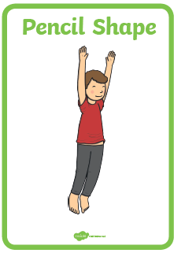
Can you do a…
Gross Fundamental movement skills they have already acquired: - rolling - crawling - walking - jumping - running - hopping - skipping – climbing

Slide 14
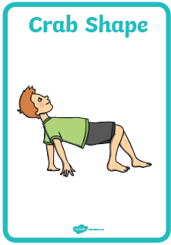
Can you do a…
Gross Fundamental movement skills they have already acquired: - rolling - crawling - walking - jumping - running - hopping - skipping – climbing

Slide 15

Lets cool down our bodies!
https://www.youtube.com/watch?v=0it4SNlKEYw

